Slide 1
Limited Arbitrage in Equity Market
Topics in Quant Finance
Mark Mitchell, Todd Pulvino, and Erik Stafford

Slide 2
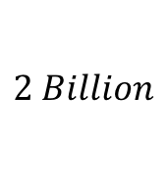
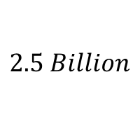
Free lunch?
Long $\frac{X}{P_{Parent}}$ Shares
Parent Company
Subsidiary
Subsidiary
Subsidiary
$$2 Billion$$
$$=$$
Short $\frac{X}{P_{sub}}$ Shares
$$2.5 Billion$$
$$=$$

Slide 3
Free lunch? No.
Can NOT implement the strategy without initial capital
Initial margin requirement (market friction)
Margin call when prices diverge
The investment is NOT risk free
The prices may never converge (imperfect information)
There maybe no arbitrage at all (Off balance sheet)
Realized return < risk-free rate
Diverging forces liquidation
Financing Risk: Margin risk
Fundamental Risk
Fundamental Risk
Financing Risk: Horizon risk
Financing Risk: Margin risk

Slide 4
Empirical Study Setup
Target
Authors studied 82 “arbitrage” situations to exam the possibility/performance of such investment strategy
Data
82 situations (more trading opportunities)
Time
1985 - 2000

Slide 5
Definition

Slide 6
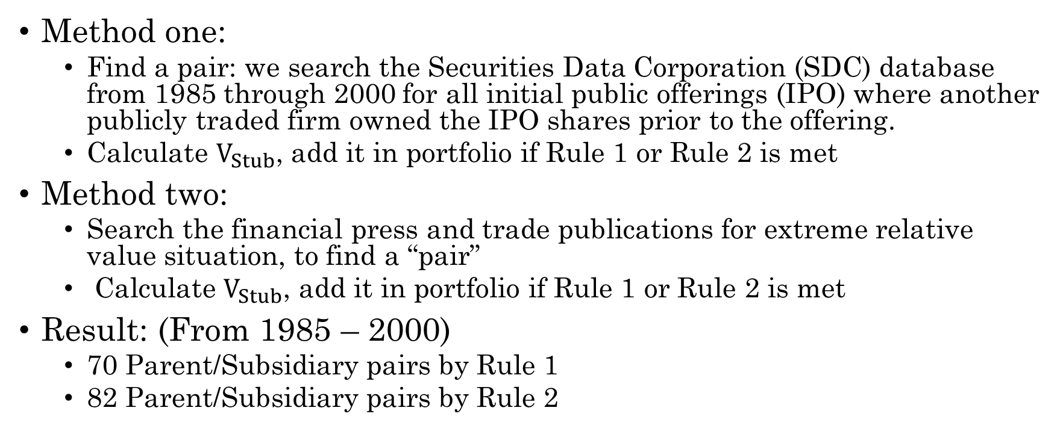
Sample Construction
Method one:
Find a pair: we search the Securities Data Corporation (SDC) database from 1985 through 2000 for all initial public offerings (IPO) where another publicly traded firm owned the IPO shares prior to the offering.
Calculate $V_{Stub}$, add it in portfolio if Rule 1 or Rule 2 is met
Method two:
Search the financial press and trade publications for extreme relative value situation, to find a “pair”
Calculate $V_{Stub}$, add it in portfolio if Rule 1 or Rule 2 is met
Result: (From 1985 – 2000)
70 Parent/Subsidiary pairs by Rule 1
82 Parent/Subsidiary pairs by Rule 2

Slide 7
Shares Outstanding and Short Rebates
Shares outstanding
Quarterly company filings of financial reports
Short Rebate
Ameritrade (Dec 1998 – Oct 2000)
20-50 bps less than Fed Fund Rate

Slide 8
Investment Strategy and Return
Criterion by which the stub is judged to be mispriced
The buy threshold
The sell threshold
The financial leverage used(Initial investment capital)

Slide 9
The financial leverage used (for Initial Investment Capital)
“Textbook” Leverage
First assumption: 50%*(long mkt value + short mkt value)
Second assumption: no maintenance margin requirements (no margin call)
“Regulation T” Leverage
Initial margin same as above
Maintenance margin
E.g. NYSE and NASD requires minimum margin = 25%*long + 30%*short
“Conservative” Leverage
Manually calculated IIC that won’t trigger any margin call.
“Gods eye”

Slide 10
Accessing Investment Return
Performance of negative-stub-value investment will be summarized in:
Assuming held individually
Investment horizon is 1 year, or holding period + risk free rate
Mean annualized return – risk-free rate
Frequency of negative returns, margin calls
Assuming in a portfolio
Individual initial weight <= 20%
Rebalance when 1)Trigger trade signal 2)Terminated by an events 3) Maintenance margin call
Summarize return from a calendar-time-portfolio vs FF3F model

Slide 11
Frequency of Convergence
Conclusion:
A decent amount of “arbitrage” NEVER converge!

Slide 12
Individual Investment Returns Using Rule 1
Conclusion:
Return are very volatile
High chance of getting margin call

Slide 13
Calendar-time Portfolio Regression Results
Conclusion:
No strong proof of Alpha

Slide 14
Fundamental Risk
Definition:
the possibility that the negative stub-value trade is terminated before prices converge to fundamental values
Break of Parent-Subsidiary Link

Slide 15
Financing Risk 1) Horizon Risk
Definition:
Trading days between trade signals
Conclusion:
Uncertainty over the time until convergence is large and has a significant effect on returns
Using rule 1, 10% of the investment is worse than risk free securities
Using rule 2, 25% of the investment is worse than risk free securities.

Slide 16
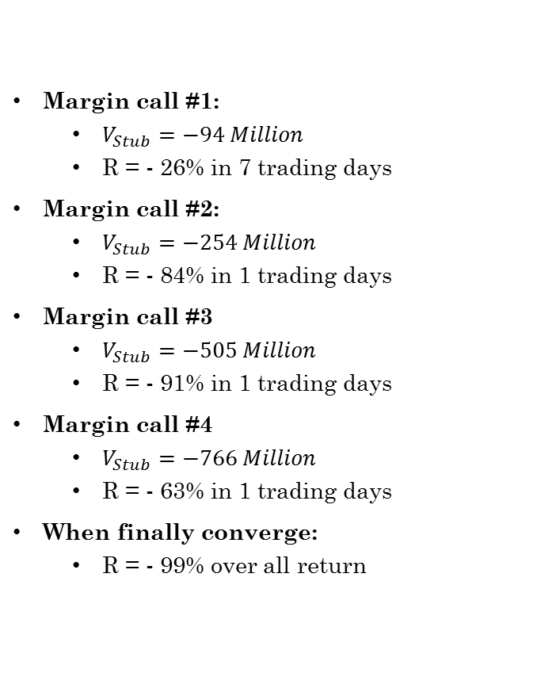
Financing Risk 2) Margin Risk
Creative Computers (CC) – Ubid
Margin call #1:
$V_{Stub}=−94 Million$
R = - 26% in 7 trading days
Margin call #2:
$V_{Stub}=−254 Million$
R = - 84% in 1 trading days
Margin call #3
$V_{Stub}=−505 Million$
R = - 91% in 1 trading days
Margin call #4
$V_{Stub}=−766 Million$
R = - 63% in 1 trading days
When finally converge:
R = - 99% over all return
Liquidate
Liquidate
Liquidate
20% Ubid for IPO
Distribute remaining 80% to CC’s current stockholders after 6 month
1 share CC Long + 0.72 shars Ubid Short
$V_{Stub}=−28 Million$
Regulation T leverage (realistic margin requirement)
R = 45% at the end of the 6 month
Liquidate
Close

Slide 17
Individual Investment Returns Using Rule 1
Conclusion:
Return are very volatile
High chance of getting margin call

Slide 18
Calendar-time Portfolio Regression Results
Conclusion:
No strong proof of Alpha

Slide 19
Comments: about the “arbitrage”
Financing Risk
Timing is fatal
Market can be “insufficient” in some cases, which cause divergence
Fundamental Risk
Arbitragers’ profit comes from investors
Arbitragers close position, they sell and buy with different investors covering EACH SIDE
They have to wait until BOTH SIDES of the market make consensus on the valuation

Slide 20
Comments: about the paper
Too simple screening for “pairs”
Used only public share info
Off balance sheet items
Some useless assumption:
“Textbook” leverage: not practical
“Conservative” leverage makes no sense
Short rebate rate
Cases from 1985 – 2000
Rebate data from Dec.1998 – Oct. 2000
This is a profitable business, because hedge fund managers should be able to know more about a specific deal than the authors.

